Slide 1
Introduction
Contents: What is OS? OS Architecture, Objectives and Functions of OS, History, Kernel, Introduction to process Control and States etc

Slide 2
What is OS?
A system program that acts as an intermediary between a user of a computer and the computer hardware.
Operating Systems goals:
  Execute user programs and make solving user problems easier.
  Make the computer system convenient to use. (User interface, API)
  Use the computer hardware in an efficient manner.

Slide 3
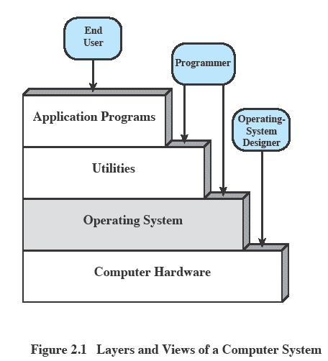
Layers and Views

Slide 4
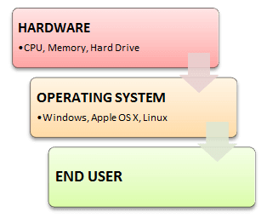
Layers and Views

Slide 5
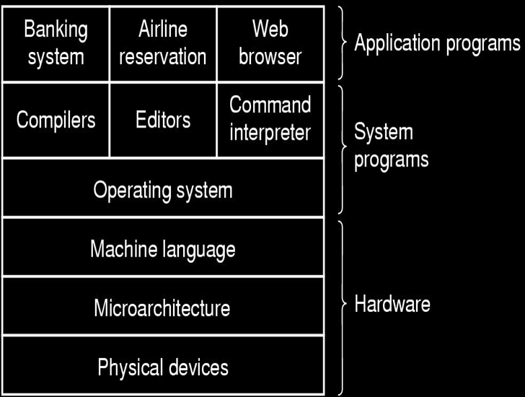
Computer System

Slide 6
Objectives of OS?
Convenience
    Make computer user friendly.
Efficiency
    Allow computer to use resources efficiently.
Ability to involve
    constructed in a way to permit effective development, testing and introduction of new functions without interfering with service

Slide 7
Functions of OS?
Interface - Acts as an abstract virtual machine
    Hides the details from user
    Control execution of programs and operations of control devices
Resource manager - Maximize system utilization and/or performance
    Time and space
    Sharing of limited or expensive physical resources
    Provides Protection
    File storage, network communications, etc.

Slide 8

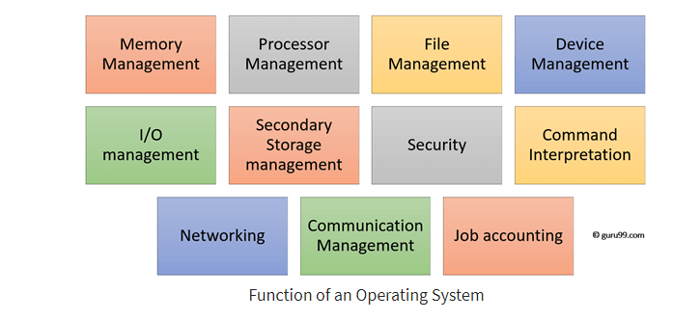
Functions of OS?

Slide 9
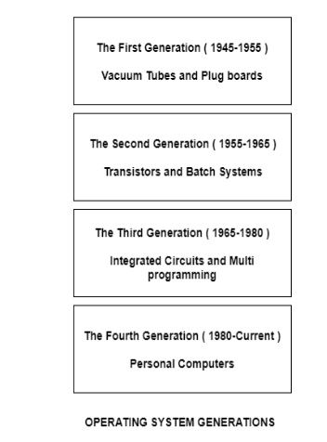
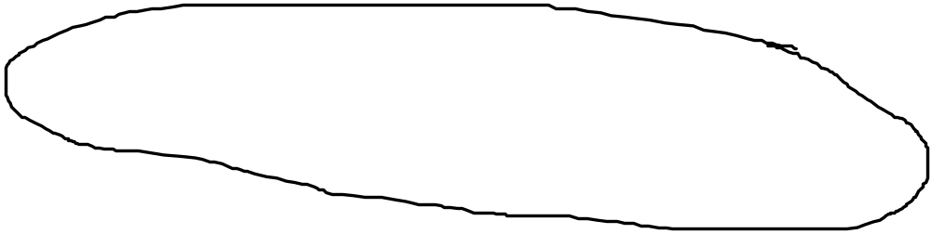
History

Slide 10

History
First generation 1945 – 1955 - Vacuum tubes, Plug boards
Second generation 1955 – 1965 - Transistors, Batch systems
Third generation 1965 – 1980 - ICs and Multiprogramming
Fourth generation 1980 – present - Personal Computers

Slide 11
History
Operating systems were first developed in the 1950s to manage tape storage
The General Motors Research Lab implemented the first OS in the early 1950s for their IBM 701
In the mid-1960s, operating systems started to use disks
In the late 1960s, the first version of the Unix OS was developed
The first OS built by Microsoft was DOS in 1981.
The present-day popular OS Windows first came to existence in 1985 when a GUI was created and paired with MS-DOS.

Slide 12
Evolution of OS
Early Systems (1950)
Simple Batch Systems (1960)
Multiprogrammed Batch Systems (1970)
Time-Sharing and Real-Time Systems (1970)
Personal/Desktop Computers (1980)
Multiprocessor Systems (1980)
Networked/Distributed Systems (1980)
Web-based Systems (1990)

Slide 13

Uniprogramming
Processor must wait for I/O instruction to complete before proceeding

Slide 14
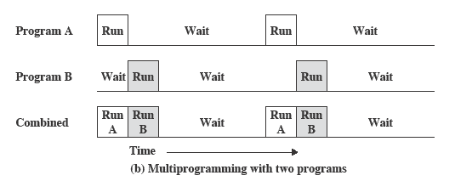
Multiprogramming
When one job needs to wait for I/O, the processor can switch to the other job

Slide 15
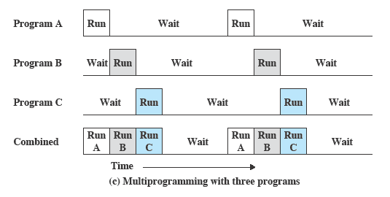
Multiprogramming

Slide 16
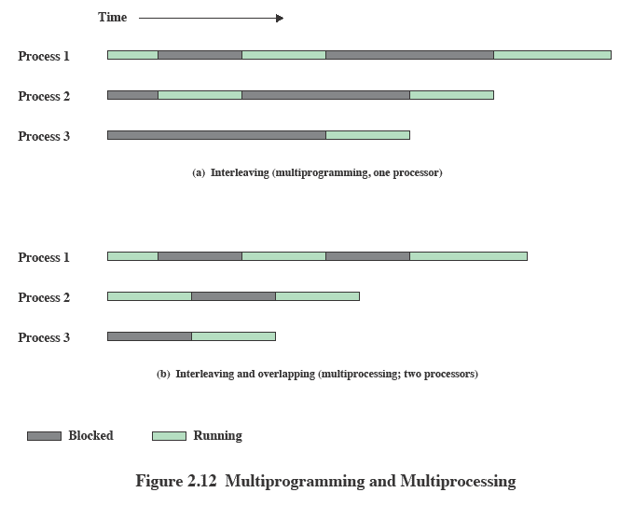
Multiprogramming & Multiprocessing

Slide 17
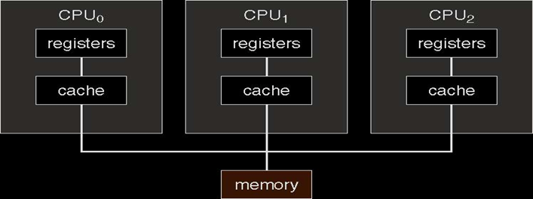
Multiprocessor Architecture

Slide 18
Today’s Range of OS
Mainframe operating systems (z/OS, Z/VM, Linux)
Server operating systems (Mac OS X Server, Windows Server)
Multiprocessor operating systems (Unix, NT, 2000)
Personal computer operating systems (Windows 7,8, XP)
Real-time operating systems (RTLinux, Windows CE)
Embedded operating systems (Embedded linux, BlackBerry iOS)
Smart card operating systems

Slide 19
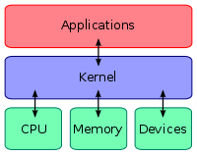
Kernel

Slide 20
Kernel
The kernel is the central component of OS; it is a bridge between applications and the actual data processing done at the hardware level.
The kernel's responsibilities include managing the system's resources (the communication between hardware and software components).

Slide 21
Kernel
Usually as a basic component of an operating system, a kernel can provide the lowest-level abstraction layer for the resources (especially processors and I/O devices) that application software must control to perform its function.
It typically makes these facilities available to application processes through inter-process communication mechanisms and system calls.

Slide 22
OS Architecture
Monolithic
Microkernel
Layered Kernel
Nano kernel

Slide 23
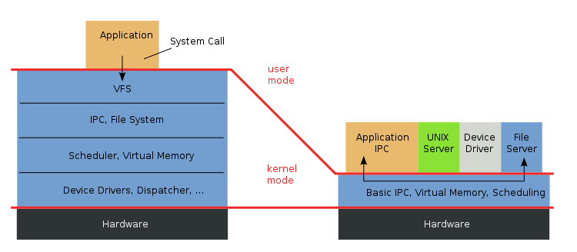
Monolithic vs. Microkernel

Slide 24
Monolithic
The term "Monolithic". The first part--"Mono" means "one". The second part--"lithic" means "it is like stone".
The entire Kernel executes in Kernel space at Ring 0. It provides a higher level interface over computer resources and hardware. It also provides a basic set of system calls via the System API.

Slide 25
Monolithic
Most of Kernel services are part of the kernel, itself. This does not mean that the services cannot be independent of each other. However, the software is very tightly integrated to the rest of the kernel. This makes monolithic kernels very fast and efficient, compared to other designs.
Because all OS services run in kernel space as part of the kernel (or as an extension to the kernel), if there is a problem with a device driver or a system service program, it can cause the entire system to crash.

Slide 26
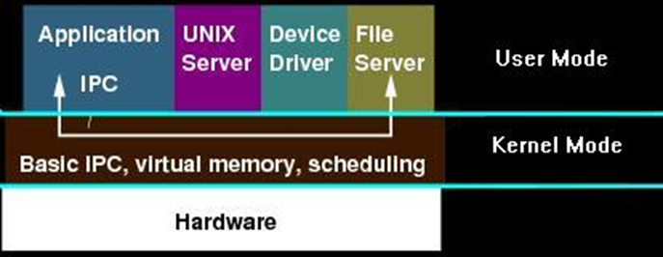
Microkernel

Slide 27
Microkernel
This structure removes all non-essential components from the kernel and implement them as system and user level programs.
Microkernel typically provides minimal process and memory management in addition to communication facility.
The main function of microkernel is to provide the communication facility between the client program and the various services that are also running in user space.
It provides more security and reliability since most services are running as user- rather than kernel processes.

Slide 28
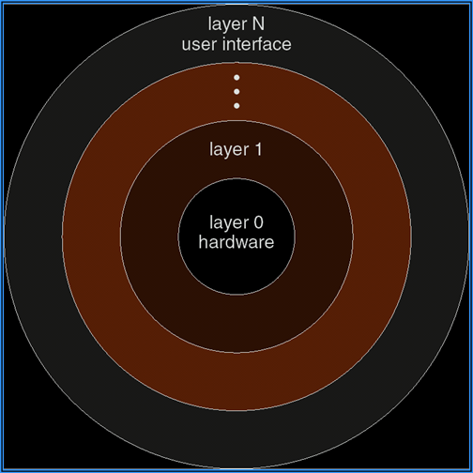
Layered Kernel

Slide 29
Layered Kernel
The OS is broken up into number of layers (or levels), each built on top of lower layers. The bottom layer (layer 0) is the hardware and highest (layer N) is the user interface. The main advantage is modularity.
The layers are selected such that each uses functions (or operations) and services of only lower-level layers. This approach simplifies debugging and system verification.

Slide 30
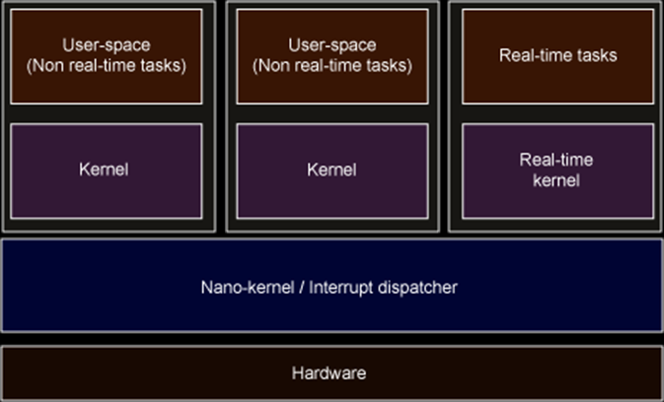
Nano Kernel

Slide 31
Nano Kernel
A kernel where the total amount of kernel code, i.e. code executing in the privileged mode of the hardware, is very small.
The term picokernel was sometimes used to further emphasize small size.

Slide 32
Modern OS
Multithreading - Process is divided into threads that can run concurrently. Thread is the dispatchable unit of work executes sequentially and is interruptible, Process is a collection of one or more threads
Symmetric multiprocessing (SMP) - There are multiple processors, share same main memory and I/O facilities, All processors can perform the same functions
Distributed - Provides the illusion of a single main memory space and single secondary memory space
Object-oriented design - Used for adding modular extensions to a small kernel, Enables programmers to customize an operating system without disrupting system integrity

Slide 33
Generations
Mainframe Systems
Desktop Systems
Multiprocessor Systems
Distributed Systems
Clustered Systems
Handheld Systems

Slide 34
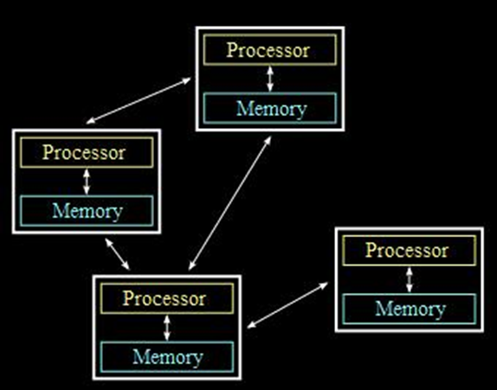
Distributed Systems

Slide 35
Clustered System
Clustered system combine the best features of both Distributed System and Multiprocessor Systems.
We will refer the group of connected computers working together as one unit as a clustered system.
Clustering allows two or more systems to share external storage and balance CPU load:
    processors also have their own external memory
    communication takes place through high-speed channels

Slide 36
Process
An operating system executes a variety of programs:
    Batch system – jobs
    Time-shared systems – user programs or tasks
Process – a program in execution; process execution must progress in sequential fashion
A process includes:
    program counter
    stack
    data section

Slide 37
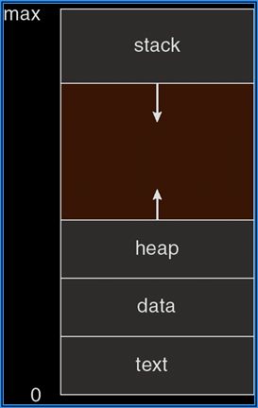
Process in memory

Slide 38
Process States
As a process executes, it changes state
  new: The process is being created
  running: Instructions are being executed
  waiting: The process is waiting for some event to occur
  ready: The process is waiting to be assigned to a processor
  terminated: The process has finished execution

Slide 39
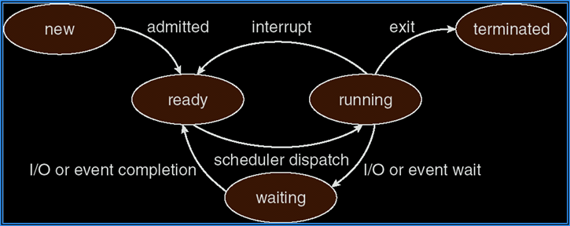
Process State Diagram

Slide 40
Process Control block
Information associated with each process
  Process state
  Program counter
  CPU registers
  CPU scheduling information
  Memory-management information
  Accounting information
  I/O status information

Slide 41
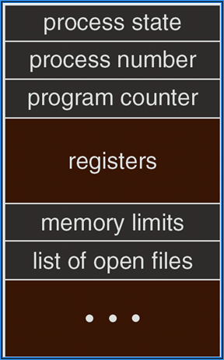
Process Control block

Slide 42
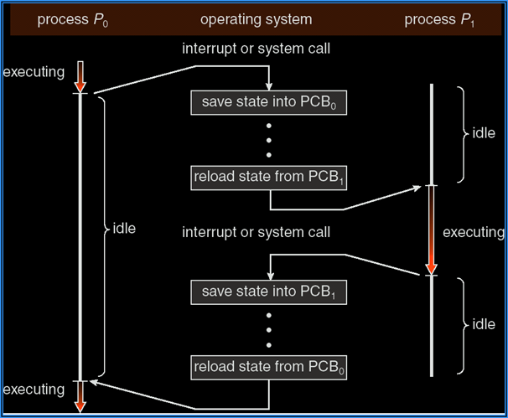
Process Switching

Slide 43
Process Creation
Parent process create children processes, which, in turn create other processes, forming a tree of processes
Resource sharing
    Parent and children share all resources
    Children share subset of parent’s resources
    Parent and child share no resources
Execution
  Parent and children execute concurrently
  Parent waits until children terminate

Slide 44
Process Creation
Address space
    Child duplicate of parent
    Child has a program loaded into it
UNIX examples
    fork system call creates new process
    exec system call used after a fork to replace the process’ memory space with a new program

Slide 45
About fork()
The fork() function is special because it actually returns twice: once to the parent process and once to the child process.
In the parent process, fork() returns the pid of the child.
In the child process, it returns 0.
In the event of an error, no child process is created and -1 is returned to the parent.

Slide 46
C Program to Create a New process
main()
{
pid_t pid;
printf(“\n Welcome”);
pid = fork(); // Child Process is Created
printf(“\n Hello”);
}

Slide 47
C Program to Create a New process
main()
{
pid_t pid1, pid2;
printf(“\n Welcome”);
pid1 = fork(); // Child Process is Created
printf(“\n Hello”);
pid2 = fork(); // Child Process is Created
printf(“\n Hello”);
}

Slide 48
C Program to Create a New process
main()
{
pid_t pid;
pid = fork();
if (pid < 0) { fprintf(stderr, "Fork Failed"); exit(-1); }
else if (pid == 0) { /* child process */
execlp("/bin/ls", "ls", NULL);
}
else { /* parent process */
wait (NULL);
printf ("Child Complete");
exit(0);
}
}

Slide 49
Revision
OS Architecture
OS Functions and Objectives
History
Types of OS
Kernel
Process management by OS

